Slide 1

CMR COLLEGE OF ENGINEERING & TECHNOLOGY
Kandlakoya, Medchal, Hyderabad - 501401
Department of Computer Science and Engineering
Student Performance In Training
Batch No.:01
Name of the student:
D. Saikiran (20H51A05G7)
B.Nikhil (20H51A05B7)
A. Haripriya (20H51A0582)
Under esteemed guidance of
Dr.K.Vijaya Kumar (Professor of CSE &DEAN)
Batch: 2020-2024 Major Project Phase 1

Slide 2
Outline
Abstract
Introduction
Research Objective
Problem Definition
Scope of the Project
Literature Review
Implementation of Existing system
Conclusion
References
Notes:
2

Slide 3
Abstract
Notes:
3

Slide 4
ABSTRACT
• The project aims to analyses the performance of the student in training that include
the no of trainings he/she attended, filtering and separation of students based on
their performance
• We can able to understand training performance of students or particular his/her
training and the particular data is analyzed represented in the form graphs
• In these project the particular student can also gave feedback to the trainings
that he/she attended and can able to know the type of trainings, when it starts
and the training and placement department can share the materials through these
website
• It is web application constitute on MERN stack These technologies include
Mongo dB, Express’s, Reacts, Nodejs. MongoDB is a cross-platform program

Slide 5
INTRODUCTION
Notes:
5

Slide 6
Introduction
The project's primary objective is to analyze student performance in technical
and non-technical training, enabling students to track their progress, identify
areas for improvement
It enhances engagement by providing access to performance data analysis,
and feedback, promoting a collaborative learning environment between students
HOD’s of respective Departments and Principal etc.
It involves two types of trainings Generally Technical and non Technical and
Technical Training involves It involves a structured three-phase technical
training program, where students progress based on performance, ensuring a
strong foundation in programming and data structures.
Non Technical involves The system evaluates non-technical skills like quant,
verbal, and reasoning through daily tests
Notes:
6

Slide 7
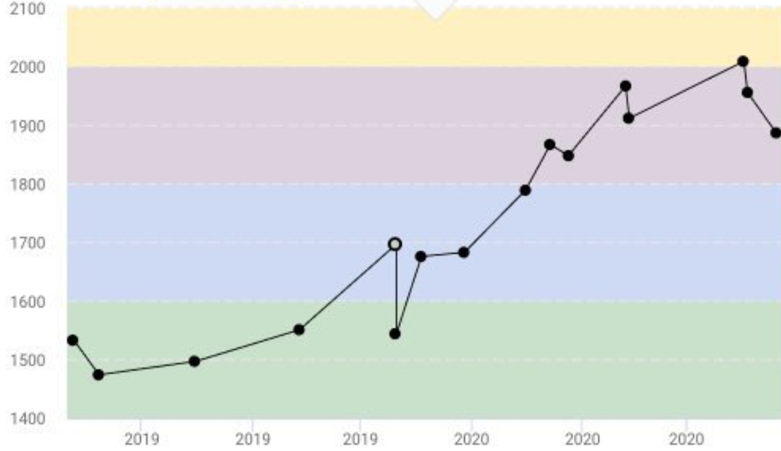
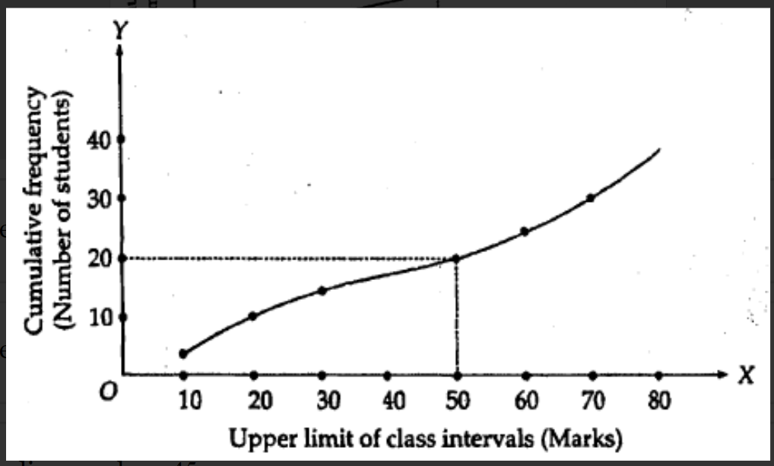
Graphs Analysis
Here we are going to represent in a cumulative way In which we know about
growth of student in a particular stage and his/her overall analysis in the tests
conducted overall training
In the second graph we are going to explain the students performance in overall
training here it can be accessed by Higher authorities like Hods ,Deans ,Principal
of the respective institutes

Slide 8
Research Objective
Notes:
8

Slide 9
Research objective
The main objective is to find or Analyze the performance of the Student
in the trainings conducted by the institute
The performance of the each Student is analyzed through the graphs in
each graph we can able to understand the growth and fall of the each
student though these graphs
The students can able to send the feedback of the trainers and rate them
according their understanding on the topics

Slide 10
Problem Definition
Notes:
10

Slide 11
Problem Definition
The study aims to identify the root causes of these challenges or problems, assess their impact on student performance, and develop effective strategies to enhance the overall effectiveness of the training program.
This problem statement provides a starting point for conducting investigation into the various issues faced by the students during the assessment process or during his/her training sessions.
This research will give us the mixed methods like quantitative analysis , aptitude, verbal learning , training sessions to give their entire performance.

Slide 12
Scope of the Project
Notes:
12

Slide 13
Scope of the Project
MERN stack allows for easy scalability. As your user base grows, you
can seamlessly expand your system to handle more traffic and users
Students can able to give feedback to lectures of trainers in these way the
management can get know the whether the trainer is efficient
React Native, which is based on React.js, can be used to develop mobile
applications for both iOS and Android platforms.
MongoDB's flexibility allows you to store and analyze vast amounts of user data.
By analyzing user behavior, helps in graphical analysis

Slide 14
Literature Review
Notes:
14

Slide 15
Comparison table for the existing system
S.No | Authors and Journal Name& Year of publication | Problem Statement | Name of the Proposed solution/Method | Solution | Remarks
1 | Performance optimization using mern stack on web application Authors : Sourabh Mahadev Malewade INTERNATIONAL JOURNAL OF ENGINEERING RESEARCH & TECHNOLOGY (IJERT)(June 2021) | In today's fast-paced business environment, the primary challenge is to understand and meet client demands efficiently and proactively. Customers expect businesses to provide online access to their products and services, ensuring convenience in their daily lives, | It leverages modern technologies and frameworks to deliver a robust e-commerce web application capable of meeting the dynamic needs of today's digital marketplace. | The MERN stack is implemented to optimize the performance s by Node.js is used for server-side development, Express.js for creating APIs , React.js for building the user interface, and MongoDB for storing and managing data. | The research highlights the importance of e-commerce in the contemporary market and demonstrates the implementation of advanced technologies to create a seamless online shopping experience
2 | Full-Stack Development using MERN Stack Author Yogesh Baiskar(january 2022) Ijraset Journal For Research in Applied Science and Engineering Technology | It focuses on full-stack development using the MERN stack., individuals often struggle to keep up with the latest tools and frameworks, hindering their ability to create efficient and interactive websites. | Author propose a detailed exploration of the MERN stack (MongoDB, Express.js, React.js, Node.js) as a solution to the challenges faced by web | The paper offers a comprehensive guide to modern web technologies, covering front-end and back-end development, databases, web stacks, deployment strategies, and digital marketing techniques. | The paper's emphasis on understanding the rapid changes in web technologies and selecting the appropriate stack for specific project requirements reflects the authors' foresight into the ever-evolving nature of the field.

Slide 16
Comparison table for the existing system
S.No | Authors and Journal Name& Year of publication | Problem Statement | Name of the Proposed solution/Method by authors | Solution | sffRemarks
3 | Introduction to MERN Stack & Comparison with Previous Technologies Authors Prof. Yogesh Kadam, 2.Akhil Goplani, 3.Shubit Mattoo Jan 2022 (published : research gate) | it discusses the MERN stack, highlighting its advantages over previous technologies such as HTML, CSS, SQL, and NoSQL | It primarily serves as an introduction to the MERN stack and a comparison with other technologies also proposed a solution re our project is to create an online system that provides interactive textbooks, notes and quizzes. | it highlights the advantages of the MERN stack for web development, such as using a single language (JavaScript) for both front-end and back-end development, cost-effectiveness due to open-source technologies | It focuses onReact vs. HTML/CSS SQL vs. MongoDB and NoSQL Databases MongoDB vs. Other NoSQL Databases
4 | College ERP Using MERN Stack - A Comprehensive Review* Authors:Shubham Patil, Saurav Daware (IJERT may 2021) | Traditional college management systems are manual, time-consuming, and error-prone. With the increasing number of student. | This system leverages the MERN stack, which comprises MongoDB, Express.js, React.js, and Node.js, to create, a scalable platform for managing various activities within a college to access, upload, and download information securely. | it suggest to develop the mern stack website on college ERP and it comprises of frontend using React and express and backend using node and mango dB database | The proposed College ERP using MERN stack addresses the limitations of manual systems by offering an integrated, cloud-based solution JavaScript-based development environment from the front-end to the back-end. This approach ensures seamless communication, quick data processing and updates

Slide 17
Comparison table for the existing system
There are websites like Hacker rank, Hackerearth(coding platform) doesn’t
show the performance in terms of graphical analysis and there performance
in each level of exam
Our website is dedicated to a organization which each performance of student
is analysed in trainings and it represented through analysis graphs
These website can even show details like no of students attended the student
and his/her attendance percentage
Notes:
17

Slide 18
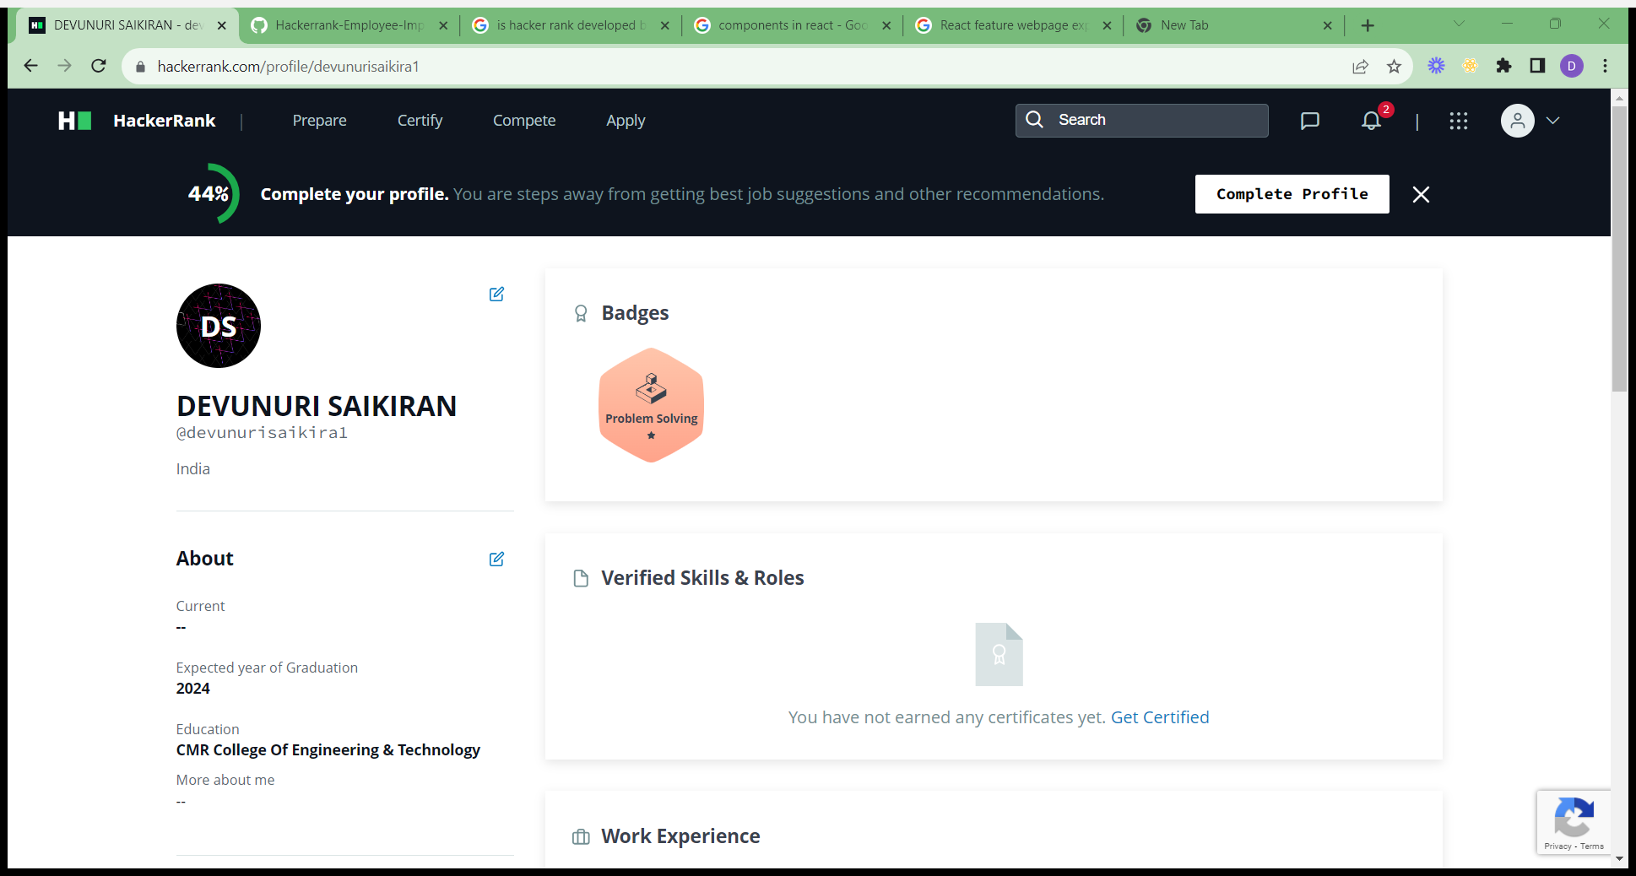
Implementation of Existing System
Existing System Hacker Rank Platform Implemented by MERN Stack and it is developed for gaining knowledge by practicing coding problems
The Projects focuses and gives the information how he good at coding and it’s
frontend is developed by react and backend by NodeJS , ExpressJs , Mango DB
React is frontend Technology it contains components and props and Hooks

Slide 19
Implementation of Existing System
Components are Reusable by using ReactJs and props are Parameter (props) is used to pass the information from one page to another
Backend Like Node.js is used to create a backend environment to run the server helpful in creating Http request and response from the server and also developing API
The Existing System uses Mango DB for data access like Authentication, features like problem solving and express is a framework helps Nodejs to Work on API(Application Programming Interface)

Slide 20
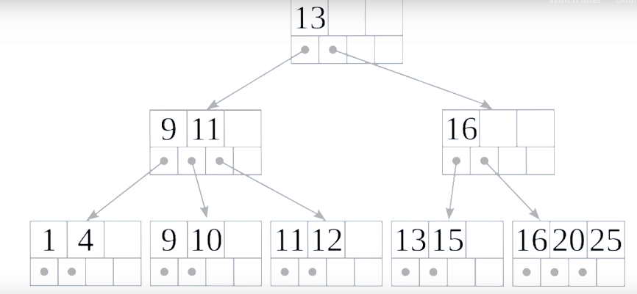
Indexing Algorithm(Mango DB)
B-tree (Balanced Tree) indexing is a widely used indexing structure in databases,
including MongoDB, to improve the efficiency of data retrieval and queries.
It provides a balanced and hierarchical structure that allows for efficient insertion,
deletion, and searching of data
In MongoDB, B-tree indexing is the default indexing algorithm and is commonly
used for fields where you need to support range queries, sorting, and equality
checks

Slide 21
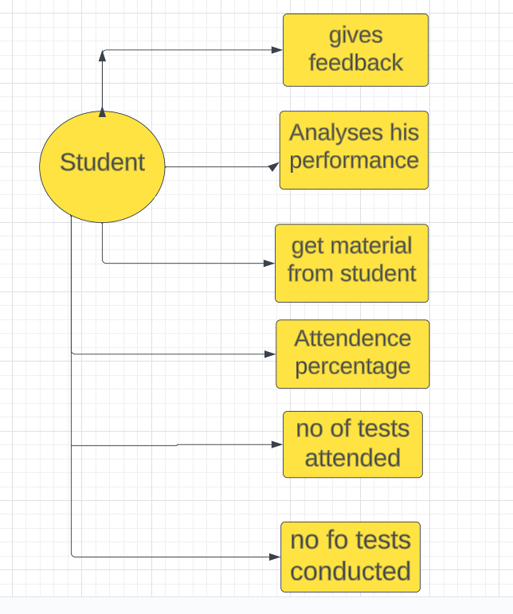
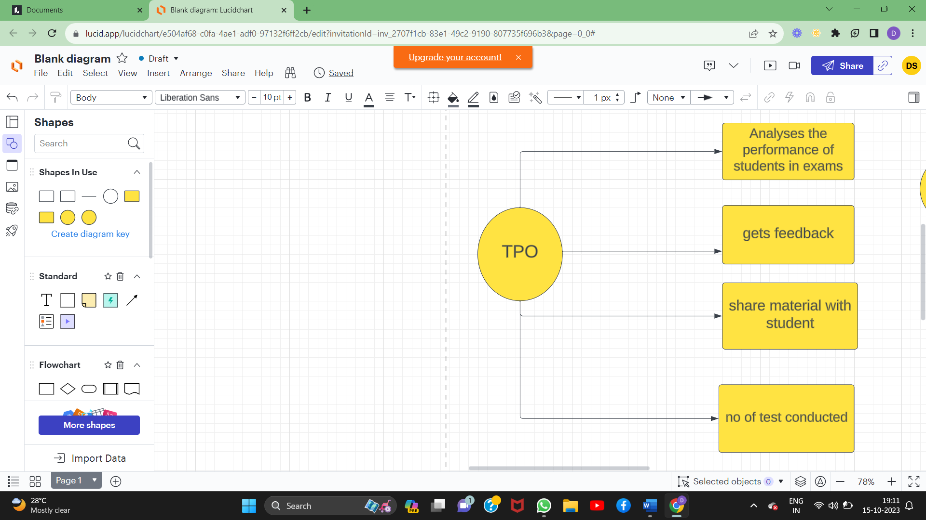
UML Diagram

Slide 22
Result
Students now have the ability to track their progress in training and as a result The system provides a clear overview of their performance, enabling them to identify areas for improvement
MongoDB's flexibility for storing and analyzing user data, the project has facilitated graphical analysis of user behavior ,this has provided data-driven insights that can be used for making informed decisions
The student training portal successfully implemented a feedback mechanism allowing students to assess their trainers

Slide 23
Conclusion
In this project it analyses the performance of students in training based on the tests attended ,classes attended and also helps In separation of students according to the different batches. Using mern stack and technologies used are mongoDB , Express ,React ,Node js.

Slide 24
References
https://www.hackerrank.com/dashboard
https://www.w3schools.com/whatis/whatis_fullstack_js.asp
https://www.geeksforgeeks.org/mern-stack/
https://www.w3schools.com/nodejs/

Slide 25
Thank You!

